Slide 1
Improving Empirical Antibiotic Prescribing in the Emergency Department Through Artificial Intelligence to Predict Multi-drug Resistant Organisms
EN.580.680: Precision Care Medicine 2024-2025
Team Ptarmigan: Chloe Sheen, Kyra Bowden, Boaz Goldberg, Yuhan Gui, Sid Raghavan
Biomedical PIs: Eili Y. Klein, PhD., Jeremiah S. Hinson, MD, PhD.
Engineering PIs: Joseph Greenstein, PhD., Casey Overby Taylor, PhD.

Slide 2
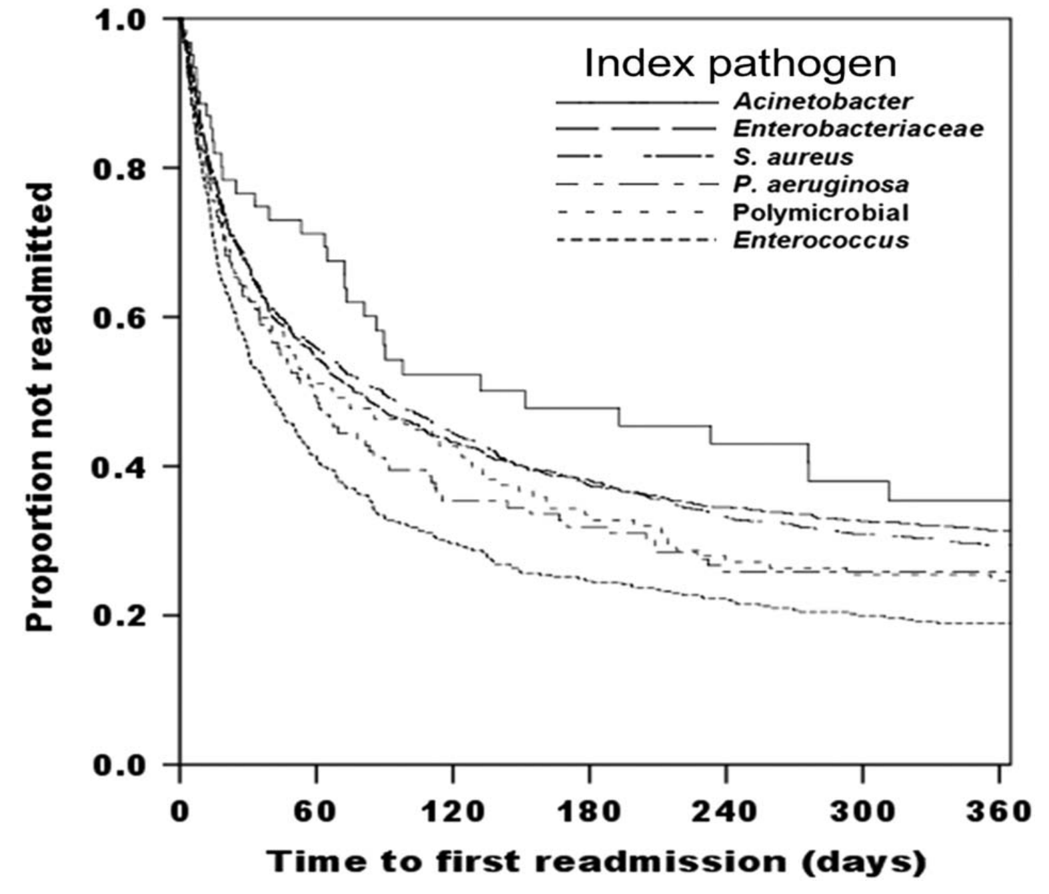

Introduction
Innovation
Aims
Approach
Timeline
Healthcare-associated infections (HAIs) caused by multidrug resistant organisms (MDROs) are a major public health issue.
3.5%-12% of patients acquire at least one HAI during their stay at the hospital
Longer hospitalizations, higher mortality rates
Burnham et al., 2018
Notes:
Main motivation
HAI are infections that patients acquire while receiving medical treatment in a healthcare setting.
left side:
in average, upwards of 12%
Some patients may arrive already infected, and these cases can spread infections within hospital through transmission.
May be asymptomatic but further spread pathogens to healthy patients.
patients with MDRO infections are at higher risk of readmission, and readmission typically leads to higher mortality rates.
Among MDRO hospitalization survivors, one in three patients were readmitted at least once within 30 days after discharge and 60% were readmitted within 1 year.

Slide 3

Introduction
Innovation
Aims
Approach
Timeline
Healthcare-associated infections (HAIs) caused by multidrug resistant organisms (MDROs) are a major public health issue.
3.5%-12% of patients acquire at least one HAI during their stay at the hospital
Prolonged hospital stays, post-discharge complications, infection control measures
Longer hospitalizations, higher mortality rates
Burden on healthcare facilities
Prakash et al., 2024
Notes:
Preventing HAIs is a critical part of improving patient safety and healthcare quality.

Slide 4
Introduction
Innovation
Aims
Approach
Timeline
The emergency department (ED) is a fast-paced decision-making environment, and patients are often prescribed inappropriate antibiotics.
Undertreatment: lower appropriate antibiotic coverage (leads to patient harm).
Overtreatment: unnecessary use of extended-spectrum antibiotics (leads to resistance).
Clinicians need automated MDRO risk assessments for patients in the Emergency Department to improve empirical prescriptions of antibiotics, which will lead to better patient outcomes and reduce the risk of antibiotic resistance.
Cui et al., 2024; Niforatos et al., 2024
Notes:
There is a clear need to control & prevent the spread of MDRO infections.
However, identifying these cases both accurately & rapidly remains a challenge.
limited amount of info + environment of the ED, patients are often prescribed inappropriate antibiotics.
undertreatment: insufficient amount or too short a course of antibiotics is prescribed → chronic infections, and increased risk of complications
overtreatment: more typically the case -- inappropriate broad-spectrum antibiotic that targets a wide range of bacteria → antibiotic resistance
To target these issues, ___goal___.

Slide 5
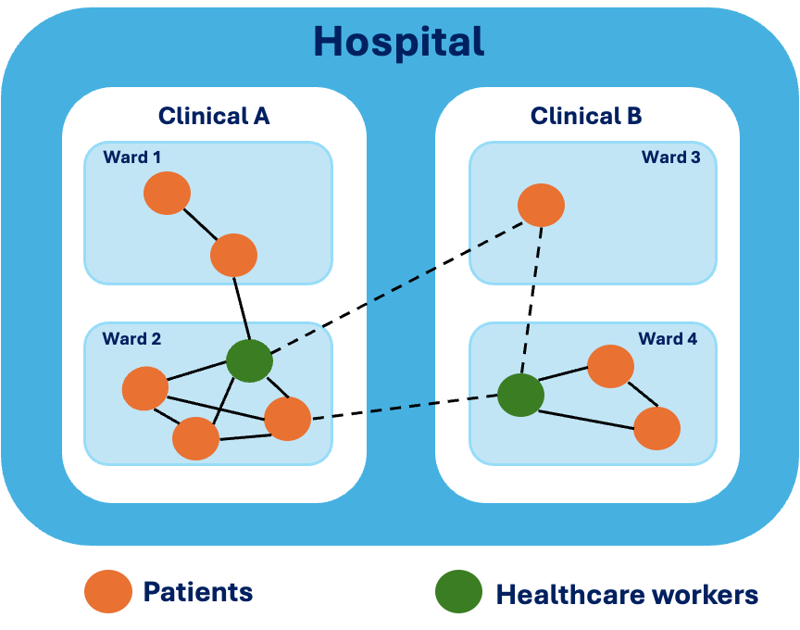
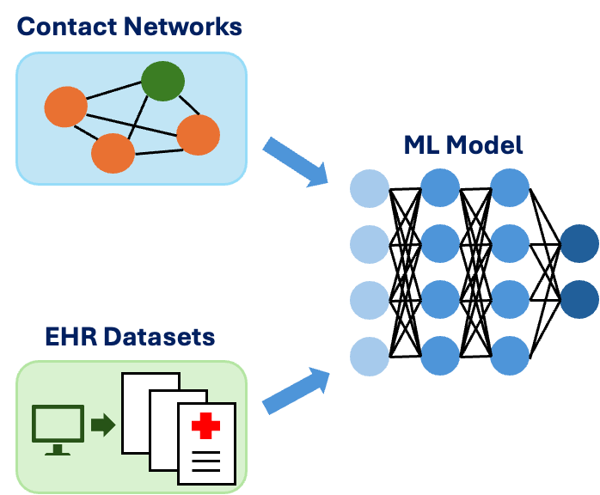
Introduction
Innovation
Aims
Approach
Timeline
Can we predict patient risk based on prior healthcare worker mediated contacts with MDRO-infected patients?
Notes:
Most prior machine learning models only considered electronic health records and culture results. While the nosocomial infection is strongly influenced by contact networks.
left figure - Contact networks: Patients in the hospital contact with healthcare workers (HCWs) and surrounding environment. MDRO-infected patients can contaminate HCWs and environment, then further infecting other patients through contacts.
right figure - Innovation: Different from previous ML models predicting a patient’s risk for an MDRO infection, we not only consider clinical and nonclinical features derived from information from a large EHR datasets in the process of training the model, but also innovatively introduce contact networks to optimize.

Slide 6
Introduction
Innovation
Aims
Approach
Timeline
prior connections
vitals
demographics
prescription
outcome
Hospital Stay
MDRO, death, or recovery
MDRO Risk Score + Recommendation
Aim 1
Data processing, Defining contact network
Aim 2
Developing machine learning model, model testing & validation
Aim 3
Overall risk score, Interpretable output, Prescription recommendation

Slide 7
Introduction
Innovation
Aims
Approach
Timeline
Demographics
gender, age, race, ethnicity
Comorbidities
HIV, Acute myocardial infarction, cancer, cerebrovascular disease, etc.
Demographic, Status, Medication
Medication
antibiotic types, cefepime/meropenem
Time Course
arrival/departure, hospital admission/discharge, medication administration, room exposure
Connections
admission source, arrival mode, prior hospitalization, prior ICU
Patient Data
Time
Vitals
Category
pulse, respiratory rate, blood pressure,
O2 saturation, temperature
128165 patients
Identified by visit ID
Value
Labs
Time
Type
Result

Slide 8
Introduction
Innovation
Aims
Approach
Timeline
Demographics
gender, age, race, ethnicity
Comorbidities
HIV, Acute myocardial infarction, cancer, cerebrovascular disease, etc.
Demographic, Status, Medication
Medication
antibiotic types, cefepime/meropenem
Time Course
arrival/departure, hospital admission/discharge, medication administration, room exposure
Connections
admission source, arrival mode, prior hospitalization, prior ICU
Patient Data
Time
Vitals
Category
pulse, respiratory rate, blood pressure,
O2 saturation, temperature
128165 patients
Identified by visit ID
Value
Labs
Time
Type
Result

Slide 9
Introduction
Innovation
Aims
Approach
Timeline
Aim 1: Define connections by using an automated data processing pipeline with variable parameters.
Patient-Staff Contacts
Lookback Window
Infectious Window
Patient-Patient Contacts
Patient Rooms
Lookback Window
Infectious Window
Contact Quantity
Contact Risk
Nosocomial Infections
Culture Results
Controls
+/-
Training/Test Data
Clinical Data

Slide 10
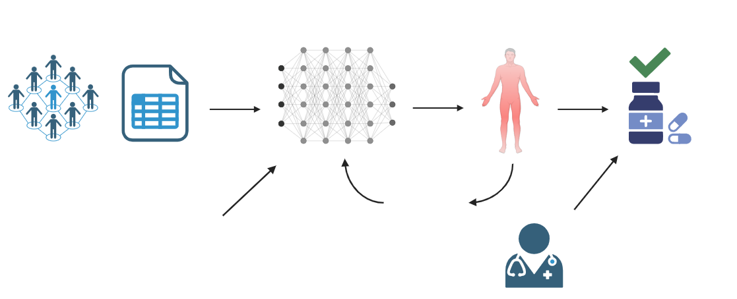

Introduction
Innovation
Aims
Approach
Timeline
Aim 2: Develop a MDRO risk-prediction model and provide antibiotic decision support.
Contact Networks; EHR data; MDRO lab results
Train Neural Network to learn importance of features
Predict probability of an MDRO from test data
Refine Model
Models:
Random Forest Classifier
Gradient Boosting (XGBoost)
Logistic Regression
Recurrent Neural Network
Graph Neural Network
Test various model iterations

Slide 11
Introduction
Innovation
Aims
Approach
Timeline
Aim 3: Provide antibiotic decision support.
Contact Networks; EHR data; MDRO lab results
Train Neural Network to learn importance of features
Predict probability of an MDRO from test data
Antibiotic Decision Support
Refine Model
Models:
Random Forest Classifier
Gradient Boosting (XGBoost)
Logistic Regression
Recurrent Neural Network
Graph Neural Network
Test various model iterations
Clinician Input + Patient Disease Information

Slide 12
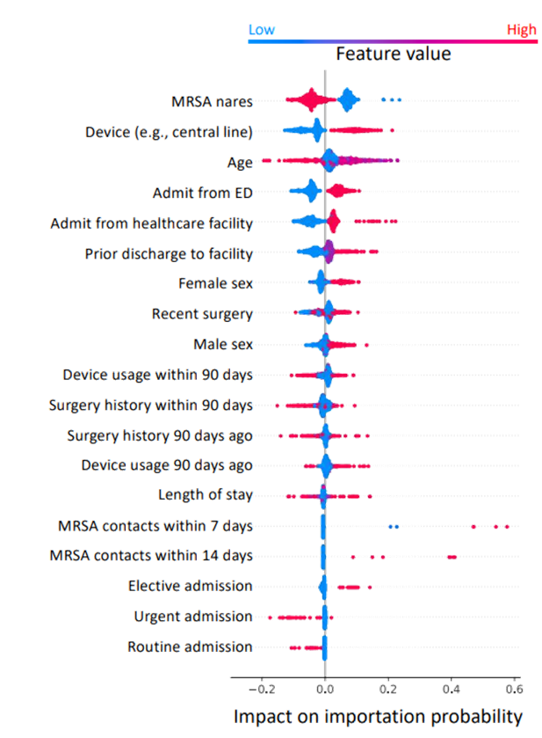
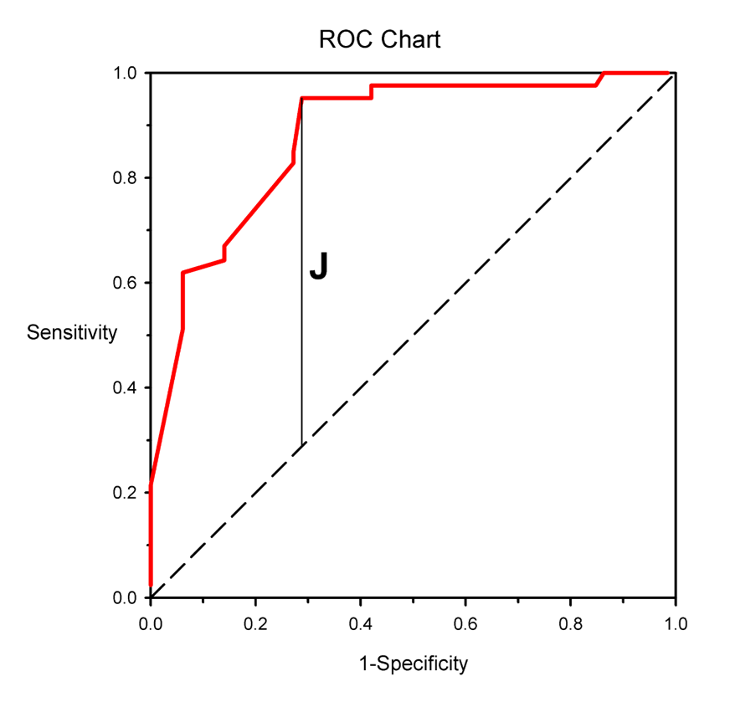
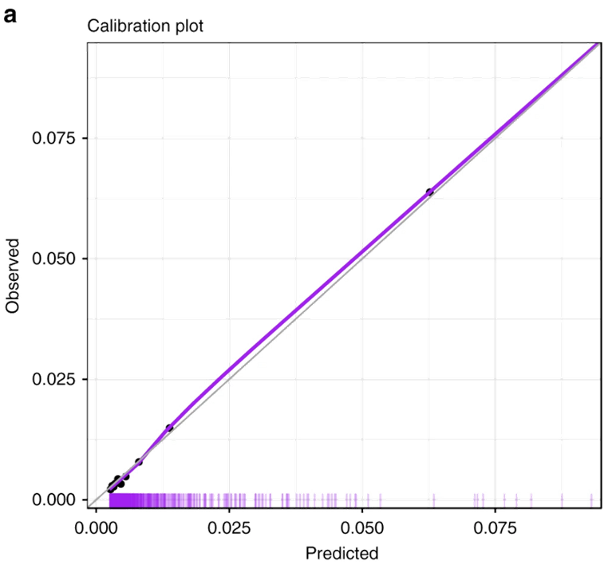
Introduction
Innovation
Aims
Approach
Timeline
Model Validation and Interpretability
Evaluate Model Performance
Interpretability
Calibration Plot
AUROC
SHapley Additive exPlanations (SHAP) analysis
COVID-19 mortality prediction
AUROC chart with Youden’s J Statistic
Identifying importation cases for MDROs in ICUs.
Find balance between True Positive Rate and False Positive Rate (overprescribing) through AUROC curve.
Barda, N. et al., 2020; Zoabi, Y. et al., 2021; Cui, J. et al., 2024
Notes:
Calibration Plots; How well do the predicted probabilities match the observed probabilities

Slide 13
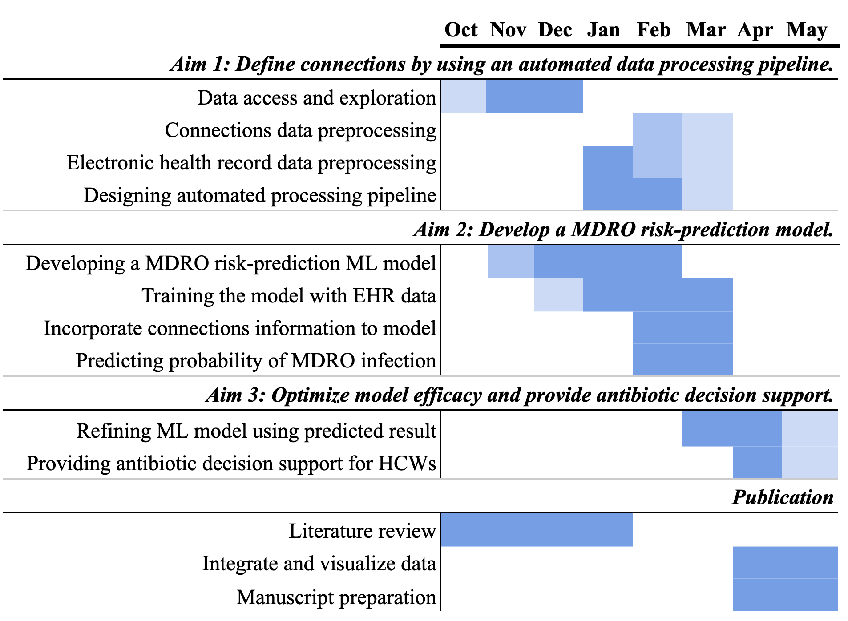
Introduction
Innovation
Aims
Approach
Timeline
Notes:
color: The shade of the color means the workload of target month, and more Dark colors mean more work
we will follow this timeline to achieve our goal step by step
1. Aim 1: We have already accessed data in IRBs and begun to pre-process data. We plan to finish data preprocessing before the end of this semester. Then further combining EHR data and designing the whole pipeline of data processing.
2. Aim 2: We decide to begin model development in November, then finish the training and predicting of the model before April next year.
3. Aim 3: After developing the machine learning model, we finally optimize the model and provide some decision support for healthcare workers (HCWs). This will be mostly finished next April.
4. Publication: In the past two months, we worked on literature review and had a clear understanding of our project.

Slide 14
References
B. Aditya Prakash, Jiaming Cui, Jack Heavey et al. Identifying Importation and Asymptomatic Spreaders of Multi-drug Resistant Organisms in Hospital Settings, 18 July 2024, PREPRINT (Version 1) available at Research Square [https://doi.org/10.21203/rs.3.rs-4687761/v1]
Smith, D. L., Dushoff, J., Perencevich, E. N., Harris, A. D. & Levin, S. A. Persistent colonization and the spread of antibiotic resistance in nosocomial pathogens: resistance is a regional problem. Proc. Natl. Acad. Sci. 101, 3709–3714 (2004).
Eili Y Klein, Katie K Tseng, Jeremiah Hinson, Katherine E Goodman, Aria Smith, Matt Toerper, Joe Amoah, Pranita D Tamma, Scott R Levin, Aaron M Milstone, CDC Prevention Epicenters Program and the CDC MInD-Healthcare Program, The Role of Healthcare Worker-Mediated Contact Networks in the Transmission of Vancomycin-Resistant Enterococci, Open Forum Infectious Diseases, Volume 7, Issue 3, March 2020, ofaa056, https://doi.org/10.1093/ofid/ofaa056
Niforatos et al., in prep (from PCM slides - need to find preprint)?
Kamruzzaman M, Heavey J, Song A, Bielskas M, Bhattacharya P, Madden G, Klein E, Deng X, Vullikanti A Improving Risk Prediction of Methicillin-Resistant Staphylococcus aureus Using Machine Learning Methods With Network Features: Retrospective Development Study JMIR AI 2024;3:e48067 https://ai.jmir.org/2024/1/e48067. DOI: 10.2196/48067
Estimating the impact of healthcare-associated infections on length of stay and costs. De Angelis, G. et al. Clinical Microbiology and Infection, Volume 16, Issue 12, 1729 - 1735
Shang JS, Lin YS, Goetz AM. Diagnosis of MRSA with neural networks and logistic regression approach. Health Care Manag Sci. Sep 2000;3(4):287-297.
Raschpichler, G. et al. Development and external validation of a clinical prediction model for mrsa carriage at hospital admission in southeast lower saxony, germany. Sci. reports 10, 17998 (2020).
Tang R, Luo R, Tang S, Song H, Chen X. Machine learning in predicting antimicrobial resistance: a systematic review and meta-analysis. Int J Antimicrob Agents. 2022;60(5-6):106684.
Barda, N., Riesel, D., Akriv, A., Levy, J., Finkel, U., Yona, G., Greenfeld, D., Sheiba, S., Somer, J., Bachmat, E., Rothblum, G. N., Shalit, U., Netzer, D., Balicer, R., & Dagan, N. (2020). Developing a COVID-19 mortality risk prediction model when individual-level data are not available. Nature communications, 11(1), 4439. https://doi.org/10.1038/s41467-020-18297-9
Zoabi, Y., Deri-Rozov, S., & Shomron, N. (2021). Machine learning-based prediction of COVID-19 diagnosis based on symptoms. NPJ digital medicine, 4(1), 3. https://doi.org/10.1038/s41746-020-00372-6
Cui, J., Heavey, J., Klein, E., Madden, G. R., Vullikanti, A., & Prakash, B. A. (2024). Identifying Importation and Asymptomatic Spreaders of Multi-drug Resistant Organisms in Hospital Settings. medRxiv : the preprint server for health sciences, 2024.07.14.24310393. https://doi.org/10.1101/2024.07.14.24310393
Burnham JP, Kwon JH, Olsen MA, Babcock HM, Kollef MH. Readmissions With Multidrug-Resistant Infection in Patients With Prior Multidrug Resistant Infection. Infection Control & Hospital Epidemiology. 2018;39(1):12-19. doi:10.1017/ice.2017.254

Slide 15
Introduction
Innovation
Aims
Approach
Timeline
further directions (for final, not mid-project)
add blurb about federated learning environment here

Slide 16
Introduction
Innovation
Aims
Approach
Timeline
diagram showing how filtering is done, what the columns look like, etc.
128,165 Patient Samples
Extract important features; Filter dataset to target population
Admission_time, Discharge_time, Lab/test_result_time, Positive MDRO_result
*Data access was provided on 10/30, so will update post-meeting.
Notes:
Exclusion criteria would be helpful…

Slide 17
Introduction
Innovation
Aims
Approach
Timeline
Aim 3:
Aim 2.2: Fine-tune model to provide a clinically-relevant antibiotic plan dependent on model result.
Convert the probability of infection into a clinically relevant tool.
What specific antibiotic-agent should be used to treat a patient?
Need to utilize infection dynamics and patient disease information.
Requires clinician input from Dr. Hinson
use clinical insight to recommend broad-spectrum vs. narrow-spectrum antibiotic for treatment

Slide 18
Introduction
Innovation
Aims
Approach
Timeline
Dataset: Overview
n = 128165 patients
all identified by patient ID and visit ID
Patient Data
Demographic, Status, Medication
Vitals
Labs

Slide 19
Introduction
Innovation
Aims
Approach
Timeline
Demographic, Status, Medication
Demographics
gender, age, race, ethnicity
Time Course
arrival, ED departure, hospital admission, hospital discharge, medication administration, room exposure
Connections
admission source, arrival mode, inpatient disposition, prior hospitalization, prior ICU, prior procedures, ESBL, CP, room exposures
Comorbidities
HIV, Acute myocardial infarction, cancer, cerebrovascular disease, heart failure, pulmonary disease, dementia, diabetes, liver disease, etc.
Medication
antibiotic types, cefepime/meropenem

Slide 20
Introduction
Innovation
Aims
Approach
Timeline
Vitals
Time
Category
pulse, respiratory rate, blood pressure, O₂ saturation, temperature
Value

Slide 21
Introduction
Innovation
Aims
Approach
Timeline
Labs
Time
administration, results
Type
Result

Slide 22
Introduction
Innovation
Aims
Approach
Timeline
Aim 1: Data Processing
what is the question being asked here? what output do we want to see?
Create a preprocessing script/pipeline for generating a connected network from raw patient data.
→ deliverable: visualize with a graph
Aim 1.1: Choose models to test
Neural Network
We will also test Logistic Regression, XGBoost, and Random Forest
Aim 1.2: Generate datasets of connections using criteria
Connections from healthcare worker- and room- mediated contacts
Hospital worker contacts infected patient, than non-infected patient
non-infected patient enters room formerly containing infected patient
We will generate connections datasets by looking back from hospital-acquired infections
We will generate several datasets using different lookback criteria:
How long after a positive test are patients infectious?
How long after contracting an infectious patient is a healthcare worker infectious?
How long after an infectious patient vacates is a room infectious?
Aim 1.3: Train and Compare models on each dataset
Train each model on each dataset
Assess the performance of each model
Area under ROC curve, specificity, sensitivity etc.
Choose optimal model and dataset for future use
Notes:
Move aim 1 to later, because that should come after the model…; aim 1 should be preprocessing for getting the data ready for all the tasks we want to provide

Slide 23
Introduction
Innovation
Aims
Approach
Timeline
Aim 2: Develop a MDRO risk-prediction model
Inputs: Patient connection records, patient lab results (blood work, infection tests), age, any risk factor in the EHR that increases risk of infection.
Outputs: probability of an MDRO infection (based on prediction of the outcome of culture)-> antibiotics for treatment
start by building a model that will predict the result of a positive culture/infection given EHR data.
we will augment this model using connections from aim 1
y/n: test comes back positive.
Aim 2.1: Develop a model of risk prediction that assesses MDRO risk with high accuracy.
Data preprocessing, filter out/handling for NaN values
Data weighting - age or certain diseases will matter much more as compared to connections. (Decision Tree)
Start with a binary predictor (does the patient have an MDRO or not?)
Then, move to a probability between 0 and 1
Patients may never get an MDRO, but they might need MDRO-related antibiotics regardless, due to their condition
Model Ideas
Random Forest Classifier
Gradient boosting, XGBoost
Neural Network

Slide 24
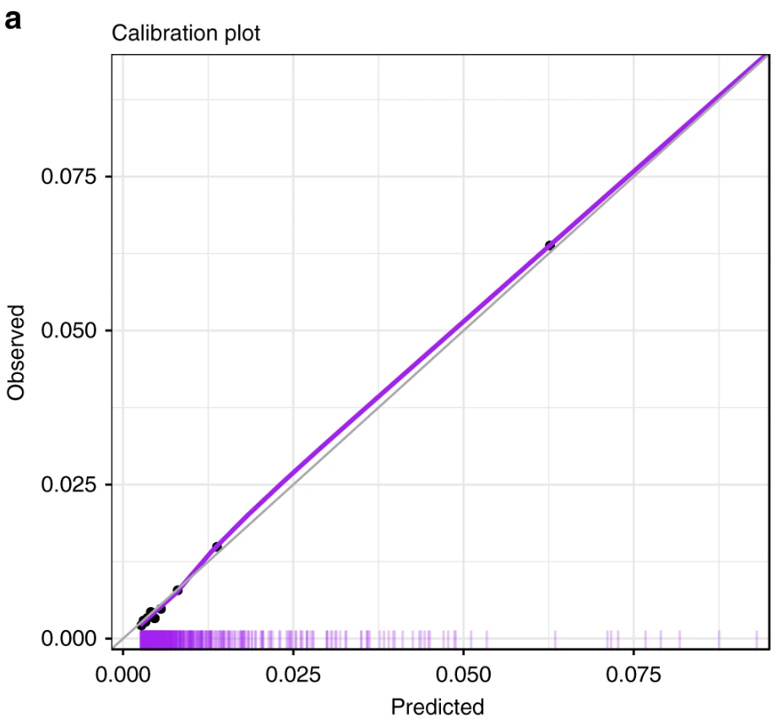
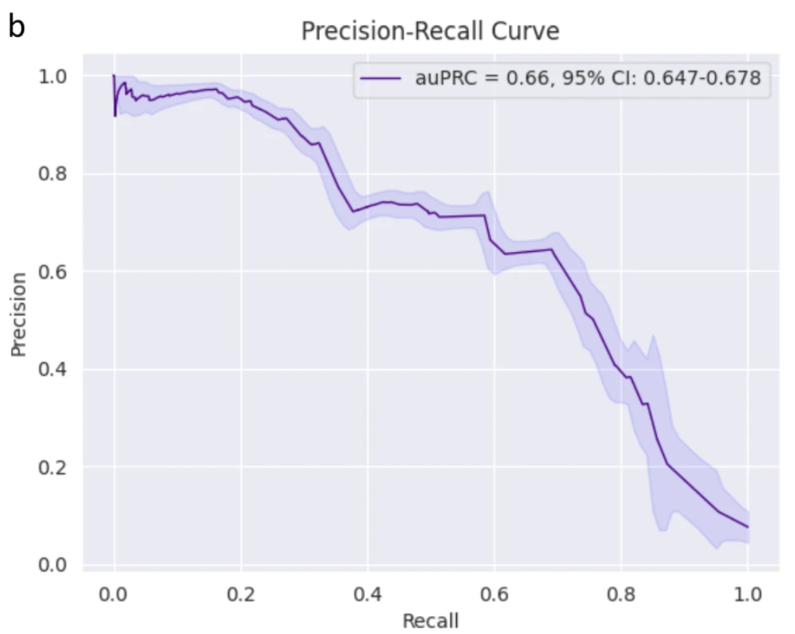
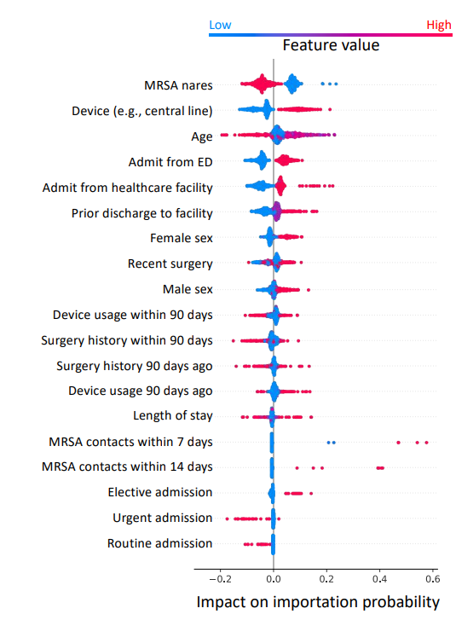
Introduction
Innovation
Aims
Approach
Timeline
Model Validation and Interpretability
Calibration Plot to Evaluate Model Performance
AUPRC to Evaluate Model Performance
SHapley Additive exPlanations (SHAP) analysis for Interpretability
COVID-19 mortality prediction
COVID-19 diagnosis prediction
Identifying importation cases for MDROs in ICUs.
Barda, N. et al., 2020; Zoabi, Y. et al., 2021;
Cui, J. et al., 2024

Slide 25
Introduction
Innovation
Aims
Approach
Timeline
Aim 3: Provide antibiotic decision support.
Find balance between True Positive Rate and False Positive Rate (overprescribing) through AUROC curve.
Youden’s J Statistic:
Probability of making an informed decision compared to a random guess.
Find balance between True Positive Rate and False Positive Rate (overprescribing) through AUROC curve.

Slide 26
Probability of making an informed decision compared to a random guess.
add a slide bringing our approaches back to how it will address undertreatment/overtreatment of antibiotics…
Use AUPRC plot as a basis for this (from Hinson exp)
TP TN
FP (overprescribing) FN (under)

